Slide 1
Etsy Music: OLS Analysis
Chase Nuzum
+
https://www.pinterest.com/etsy/
https://www.villamarketers.com/music-is-your-marketing-mojo/

Slide 2
Research Question
In the Etsy ‘music’ categories are music sellers sales determined by (a priori expectation, sign):
Traffic/Reputation (Sum of comments on items) (+)
Average pricing (-)
Etsy ‘Bestseller’ determination (+)
Offering of ‘Free-Shipping’ (+)
With OLS we can determine if their are statistically significant relationships and the partial effect related to total sales
Why don’t we use ‘ratings’, comments better proxy for reputation?
Anecdotal evidence suggested ‘everyone’ gets a 5 star rating

Slide 3
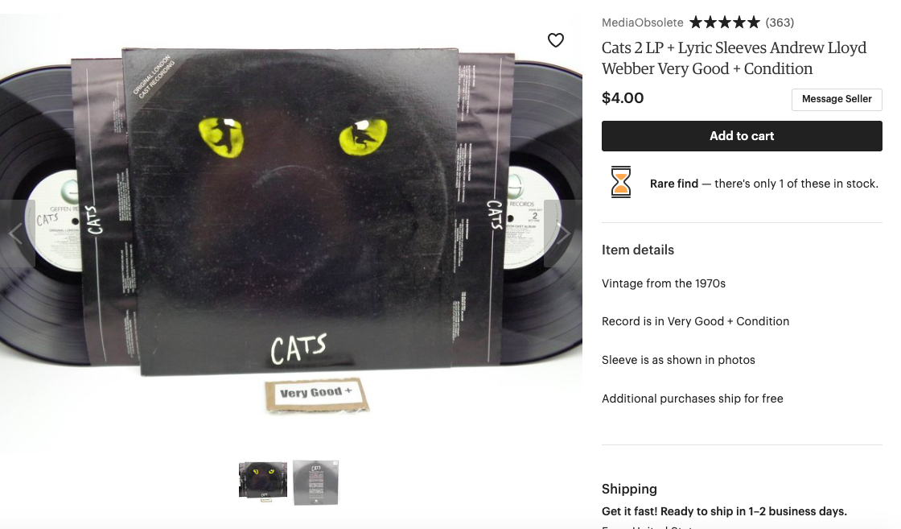

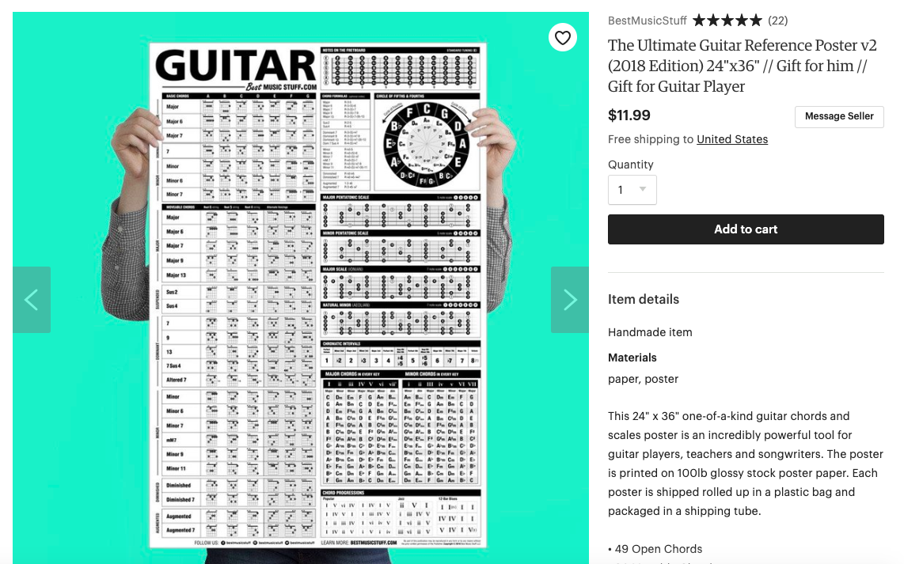
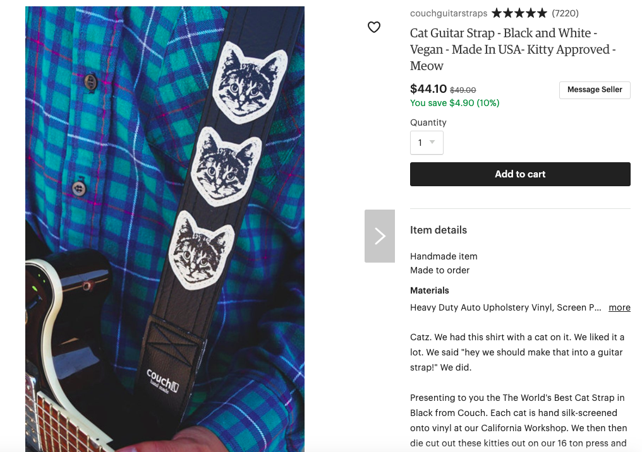

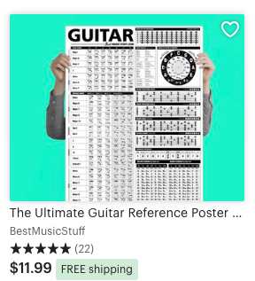
Data Selection
4 ‘start pages’ or subcategories from Etsy home page:
Recorded Audio
‘Cat’ Statuses
Instrument Straps
Instruments
‘Best-Seller’ Status
Sheet Music
‘Free-Shipping’ Status
- Consumers see ‘Bestseller’ and ‘Free-Shipping in links to items; Does this influence consumer behavior and therein seller-by-seller sales?
- All categories fall under ’Toys and Entertainment’ section of Etsy

Slide 4
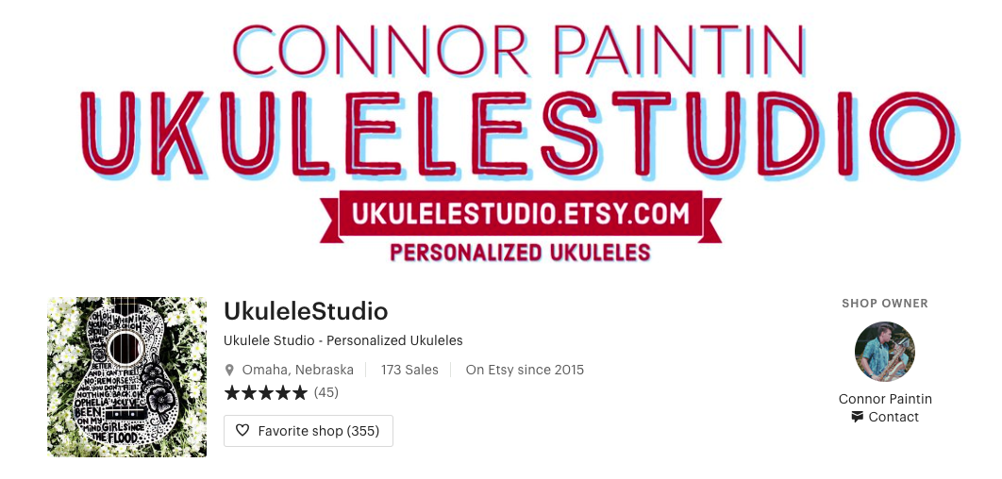
Data Selection (cont.)
Seller name and sales, found with data frame of unique seller URLs from item scape

Slide 5
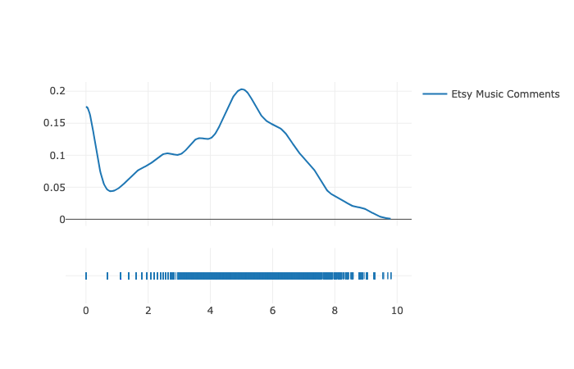
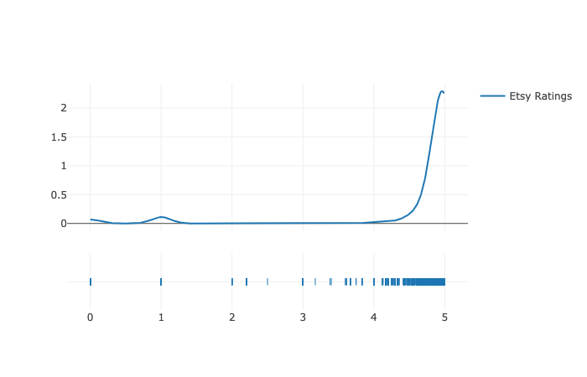
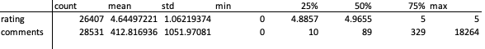
Notice Every Item and Product Had ‘5 Star Rating’?
Comments Log Distribution
Ratings Distribution

Slide 6
Data Collection Challenges
2 separate scrapy codes:
One script for all ‘music’ items: Scraped around 28,000 items from the four music categories
One script for all ‘music’ sellers: Scraped seller URLs from each item, ran separate spider for all unique seller names to collect sales number; around 5,000 sellers
Similar to SQL ‘inner join’; merged these two data frames and complied item stats on unique seller names with their sales:
Seller sales
Average pricing on all items
Sum of comments on all items
Dummy for free-shipping (assumption: 1 item free-shipping, applies to all items)
Count of ‘best-seller’ items as denoted by Etsy

Slide 7
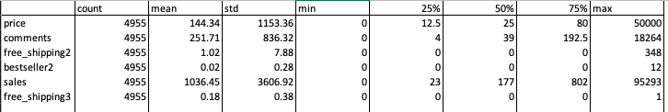
Summary Statistics

Slide 8
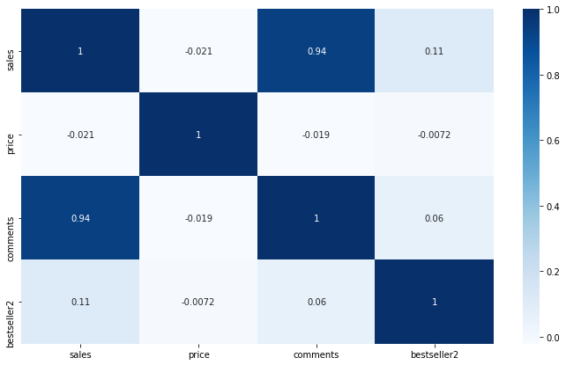
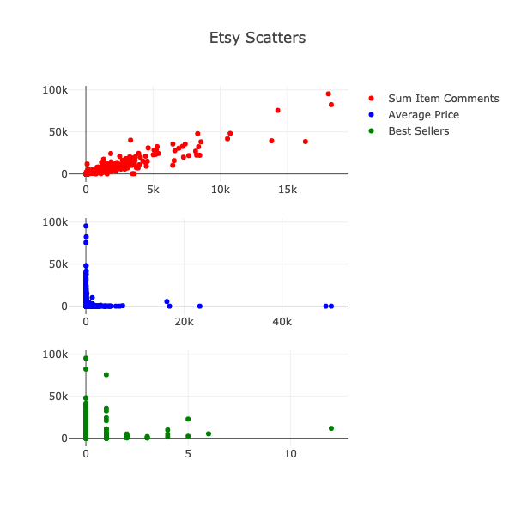
Visualization – Pre OLS Diagnostics
- Multicollinearity: No relationship between planned x’s
- Strong relationship between sum of comments and sales

Slide 9
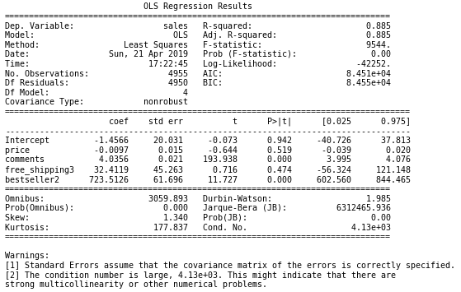
OLS Output – Nonrobust SE

Slide 10
Comments on Results
Scatterplots showed their were outliers in data
Sum of comments on items and ‘bestseller’ significant at level of .01 in relation to sales
Therefore we can conclude these items are the variables of interest
Etsy controls consumer opinion to a large degree by decreeing ‘Bestseller’ or not
Per ‘Bestseller’ item, ceteris paribus, sales increase by around 724
Because ratings tend to be ‘5 Stars’ for all items; comments serve as good indicator of quality and is significant
Per additional item comment, ceteris paribus, sales increase by around 4

Slide 11
Diagnostic Test for Heteroscedasticity
Diagnostics:
BP-Test for heteroscedasticity:
H0: Model residuals are homoscedastic
H1: Model residuals are heteroscedastic
When running BP test at level of significance of .05 we find that model BP p-value < .01
Therefore reject null and heteroscedasticity is in model; run robust standard errors

Slide 12
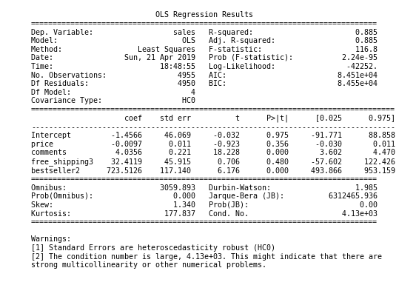
OLS Output – Robust SE
* Largely the same interpretation as before

Slide 13
Further Study…
Further fine tuning of the model
Transform outlier variables with log transformation, comments showed normal distribution with log transformation
Run with interaction variable
Collect more data; see if these results apply to other Etsy seller categories
Add location variable to see if seller location impacts sales
With more model building in forecasting can run more dynamic models
Time based analysis
Location based

